Slide 1
Part and Parcel: Predicting North American Freight Costs with Supervised Machine Learning
Kimberly Kaufman
Springboard: data science Intensive capstone project

Slide 2
Background
At Wiley, freight costs for North American outbound volume alone cost millions annually in USD. This project aims to predict the freight cost of physical book fulfillment (on both an individual shipment level and an aggregate level) by using supervised machine learning methods on a year’s worth of supply chain data out of our North American distribution center. By implementing a more complex modeling approach, we hope to improve our forecasting accuracy as well as gain better visibility into the main drivers of our costs.

Slide 3

Problem Setup
1 year’s worth of outbound volume and freight billing data
How can we leverage this data to build a predictive model around future freight costs?

Slide 4

Proposed Solution
Take a supervised machine learning approach
Run through all possible non-classifier ML models
Select the optimal model to predict cost based on RMSE and forecast variance

Slide 5
Data Set
Volume data from Wiley’s internal systems (CORE); freight data scraped from monthly billing files
All data represents FY (May – April) 2019
Volume data: 22 variables and 1,131,645 observations
Freight data: 4 variables and 129,822 observations
Merged into 1 data frame at the invoice level

Slide 6
Data Attributes
3 product description variables
ISBN, product line, global business
13 invoice level variables
Invoice dates and numbers, batch number, units per carton, cartons per pallet, pallets, cartons, & loose units picked, total units shipped, unit weight
5 transportation variables
Ship method, freight type, priority, carrier, collect flag
2 customer demographic variables
Market outlet, customer destination
1 target variable
Total freight charge (USD)

Slide 7
Data Wrangling
Missing values
Categoricals only; filled with supplementary data or values of “unknown”
Outlier handling
Capping/flooring approach used at 5th/95th percentiles for book weight
Consolidation
Volume and freight datasets joined on invoice number & interface date

Slide 8
Preprocessing
Continuous variables scaled using MinMaxScaler
(Subtracts the minimum value in the feature and then divides by the range; preserves the shape of the original distribution)
Categorical variables converted using one-hot encoding
(All non-numeric values are converted to dummy/binary variables)
Final dataset partitioned into training & test sets
80% training
20% test

Slide 9

Predictive models used
Regression methods
OLS Linear Regression
LASSO Regression
Ridge Regression
SVM & Tree methods
Decision Tree
Ensemble methods
Random Forest
Gradient Boosting

Slide 10
Methodology
Fitted on the training set
Predictions made on the test set
Performance evaluated using R² and RMSE (root mean squared error)
Initial exploratory model on OLS linear regression
Feature selection performed via LASSO regression; reduced features applied to finalized models

Slide 11

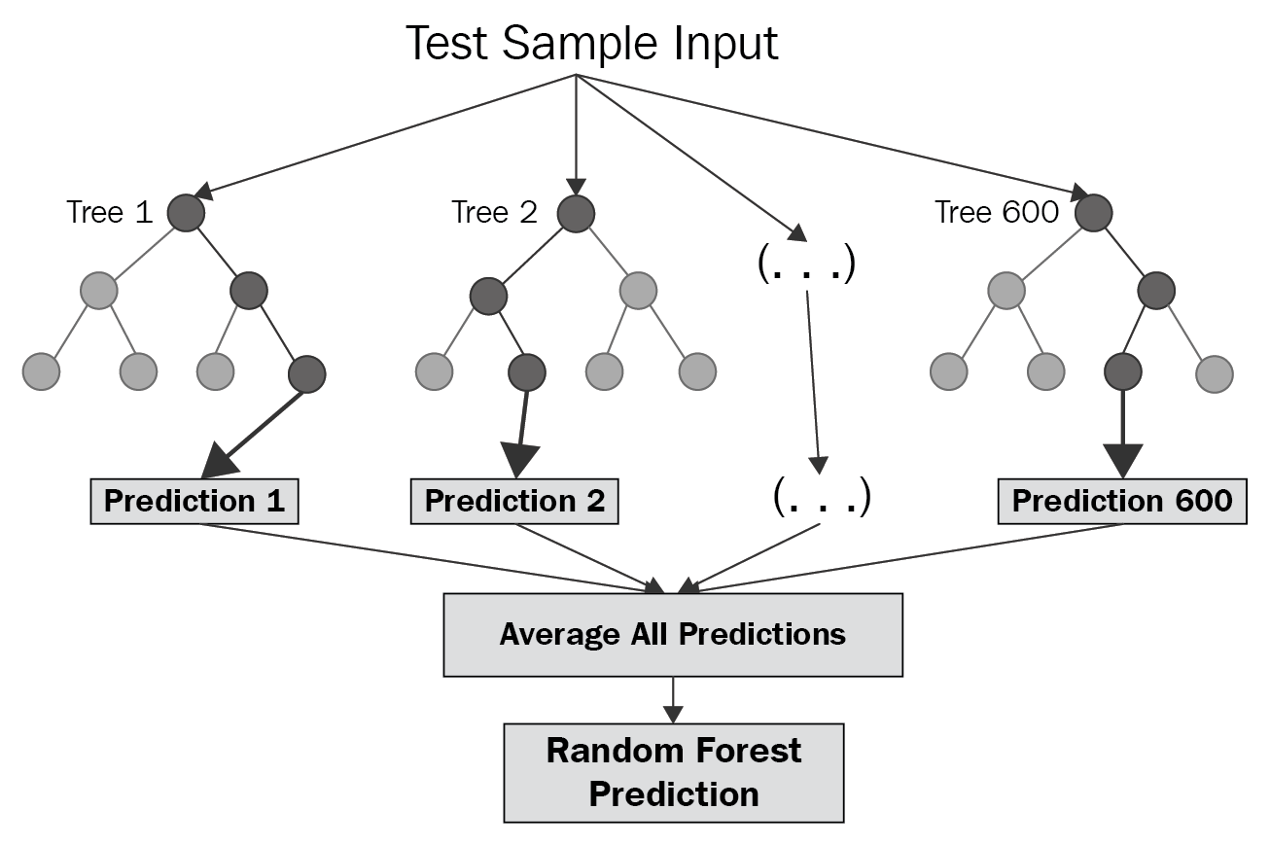
Results
Best models: Random Forest & Gradient Boosting
R² (% variance explained by the model): 40-50%
RMSE: ~20
Forecast variance: 2-3%

Slide 12
Conclusions & recommendations
Conclusions:
Relationships between outbound volume and freight appears to be both linear and non-linear in nature
Adequate modeling requires more complex methods than linear regression alone
Recommendations:
Build future forecasts with both Random Forest & Gradient Boosting
Continue to develop feature selection & hyperparameter tuning
Bring additional features into the dataset:
Geographic region (continent) as a substitute for ship-to country
Higher level market outlet groupings as a substitute for market outlet code.
Additional product types derived from more unsupervised methods such as k-means clustering.

